Slide 1

OptiProductio
Arduino-Based Real-Time WIP Monitoring and Bottleneck Detection
IEM - IDEA LAB EL

Slide 2
Team Details
Batch number: 2 Domain: Industrial Engineering & Management
Project: OptiProductio: Arduino-Based Real-Time WIP Monitoring and Bottleneck Detection
Sl. No. | Name | USN | Program
1 | Rishith Reddy | RVCE26BIM026 | IM
2 | Rohan N K | RVCE26BIM035 | IM
3 | Syed Raiyanulla | RVCE26BIM031 | IM
4 | Prem Jaju | RVCE26BIM053 | IM

Slide 3
Objectives
Main objective: Build a low-cost prototype on a 3-station model line (S1, S2, S3: Station 1, 2, 3) that measures, in real time, production count , cycle time (time a station takes per part), inventory and WIP (work in progress: parts inside the line, not yet finished). Use these to show which of four bottlenecks is causing a delay: a slow station, a breakdown, an empty raw-material bin or a burst of rejects. Then test a WIP limit (a cap on parts allowed inside the line) that stops parts piling up.
PO (project objective) | Specific objective | Measurable target | By
PO1 | Count parts at all 3 stations with IR sensors | Count error ≤ 2% against a manual tally, over three 10-minute runs | Phase II
PO2 | Live dashboard: production count, cycle time per station, WIP, bin level, downtime (time the line is stopped), OEE proxy (approximate overall efficiency) | Refreshes every 2 s or faster; all 6 values on one screen | Phase II
PO3 | Identify the bottleneck, then rebalance the line (move work from the slowest station so all stations take similar time) | Correct cause shown in 4 of 4 staged tests (each bottleneck created on purpose: slow S2, breakdown, empty bin, rejects); throughput (good parts per minute) and flow time (time for one part to cross the line) compared before and after, 3 runs each | Phase III
PO4 | WIP-limit alert on the red LED, buzzer and dashboard | Alert triggers every time WIP reaches the limit; results compared for limits of 2, 4 and 6 parts | Phase III

Slide 4
Methodology
Design: A model line of 3 stations (S1, S2, S3) in a row, with small identical parts moved by hand. The task at S2 is made longer on purpose so that S2 becomes the bottleneck. Each run lasts 10 minutes and is repeated 3 times: baseline, then rebalanced (part of S2's work moved to S1 so stations take similar time), then with a WIP limit of 2, 4 and 6 parts.
Data collection: Arduino UNO with 3 FC-51 IR sensors at the station exits (time-stamp each part leaving), an HC-SR04 ultrasonic sensor above the raw-material bin (parts left) and 3 push buttons for Breakdown, No material and Reject. Events go over USB serial (9600 baud) to a Python logger that writes a CSV event log. An LCD, red/green LEDs and a buzzer act as the andon (signal lights that warn everyone on the line).
Data analysis: From the event log we compute production count, cycle time (time a station actually works on one part, not counting time spent waiting), the bottleneck (station with the longest cycle time), WIP, throughput (good parts per minute) and flow time (time one part takes to cross the whole line). Cross-checks: Little's law [2] (average WIP = throughput × flow time) and an OEE proxy [1] (overall equipment effectiveness, approximate: availability × performance × quality).
Validation: Counts within 2% of a manual tally; the dashboard must name the right cause in 4 staged tests (each bottleneck created on purpose: slow S2, breakdown, empty bin, burst of rejects); the same code is run on the public Bosch production line dataset (Kaggle; first 50,000 rows, 3 busiest stations of line L3) [3], [4].
Tools: Arduino IDE (C++); Python with pyserial, pandas and Streamlit (dashboard refreshed every 2 s); Excel for result tables.

Slide 5
Methodology Flowchart
Physical line (parts moved by hand)
Raw material bin
HC-SR04 ultrasonic sensor (bin level)
Station 1 (S1)
IR sensor at exit (D2)
Station 2 (S2)
IR sensor (D3); slowest on purpose
Station 3 (S3): Inspection
IR sensor (D4) + Reject button
Control panel
Breakdown and No-material buttons
Arduino UNO
time-stamps every event
Andon (warning lights)
LCD, red/green LED, buzzer
Bosch public dataset
converted to the same events
Python logger
USB serial to CSV event log
WIP limit (max parts allowed inside the line) sent back to the Arduino
WIP = work in progress
parts inside the line, not yet finished
Metrics engine
count, cycle time, WIP, OEE
Streamlit dashboard
live values + WIP-limit alert

Slide 6
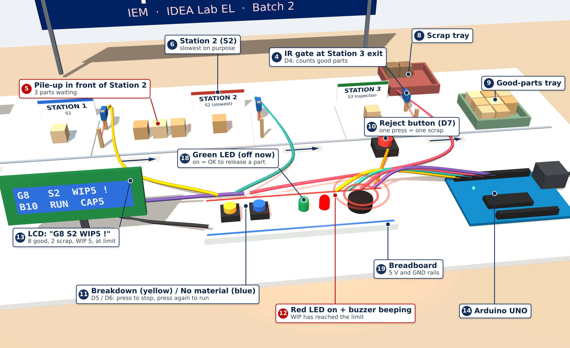
Demo Setup (3D View)
3D model of the planned demo table (control panel and Station 3 close-up). Numbers on the LCD are only for illustration.

Slide 7
References
[1] Ng Corrales, L. del C., Lambán, M. P., Hernandez Korner, M. E., & Royo, J. (2020). Overall equipment effectiveness: Systematic literature review and overview of different approaches. Applied Sciences, 10(18), 6469. https://doi.org/10.3390/app10186469
[2] Little, J. D. C. (2011). Little's law as viewed on its 50th anniversary. Operations Research, 59(3), 536–549. https://doi.org/10.1287/opre.1110.0940
[3] Mangal, A., & Kumar, N. (2017). Using big data to enhance the Bosch production line performance: A Kaggle challenge. arXiv. https://arxiv.org/abs/1701.00705
[4] Bosch. (2016). Bosch production line performance [Data set]. Kaggle. https://www.kaggle.com/c/bosch-production-line-performance

Slide 8


